Slide 1
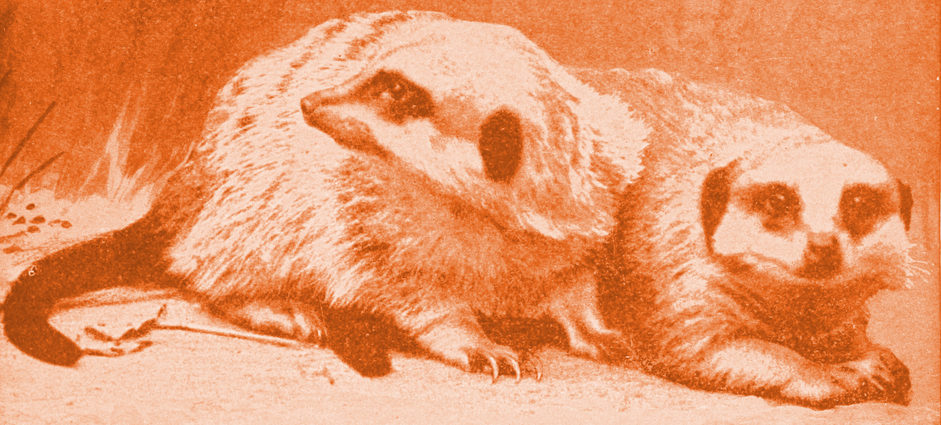
Meerkat training
Setting up Meerkat system
Jonathan & Jyri
2017/03/01

Slide 2
1. Introduction
In this training, we’ll set up a demo Meerkat system for fictional Null Island
All the data is generated from random number generator or brought from made up test cases
Due to bandwidth limitations, the setup will be done using Docker image files distributed via shared folders or USB pen drives
Windows setup for Meerkat system is slightly more complicated than for Linux
Installing the Meerkat system is more straightforward when done in an environment with high bandwidth.
For a Linux system with access to high bandwidth internet, it is enough to follow the installation steps described in the README.md in https://github.com/meerkat-code/meerkat_demo

Slide 3
Transfering and loading ISO image files
Move the following ISO files to your disk:
  dynamodb.iso
  meerkatdemo_abacus.iso
  meerkatdemo_api.iso
  meerkatdemo_auth.iso
  meerkatdemo_frontend.iso
  meerkatdemo_hermes.iso
  meerkatdemo_nginx.iso
  postgis.iso
  rabbitmq.iso
Move the following script file to same folder with the ISO files:
  load_images.sh
Run the script file from Docker terminal by entering:
  ./load_images.sh

Slide 4
Copying source code and launching system
Copy folder meerkat-code to your disk
With Docker terminal, go to folder meerkat-code/meerkat_demo
Run the following command:
  docker-compose up -d

Slide 5
Configuring virtual machine ports
Launch Windows program VirtualBox
Select virtual machine “default”
Go to Settings
In settings, select “Network”
In “Adapter 1” tab, expand the “Advanced” view
Click “Port Forwarding”
Add the following 2 port forwarding rules:
Name | Protocol | Host IP | Host Port | Guest IP | Guest Port
Rule 1 | TCP | 127.0.0.1 | 80 |  | 80
Rule 2 | TCP | 127.0.0.1 | 8888 |  | 8888

